Slide 1
Predicting Hotel Booking Cancellation

Slide 2
Project analysis slide 2
Agenda
Objective
Exploratory Data Analysis
Model Building
Feature Selection and Transformation
Model Experiment, testing & Evaluation
Model based Recommendation

Slide 3
Project analysis slide 2
Objective
Objective: Predicting Hotel Booking cancellation
Business Problem:
It is always advisable to build a predictive model to predict if a guest/customer will certainly book or not. This can help in building value added services like providing more rooms basis on the seasonal requirement and increase profitable or giving some discounts to attract the customer etc. Besides the model will also help in planning and fulfilling the demand and supply issues during the peak season when there will be more injection of customers

Slide 4
Project analysis slide 2
Explorative Data Analysis
Demographic features of the customer
How much do customer pay for a room per night?
How does the price per night vary over the year?
Yearly and monthly trend analysis
How long do customer stay at the hotels?
How are Bookings by market segment
How many bookings were canceled?

Slide 5
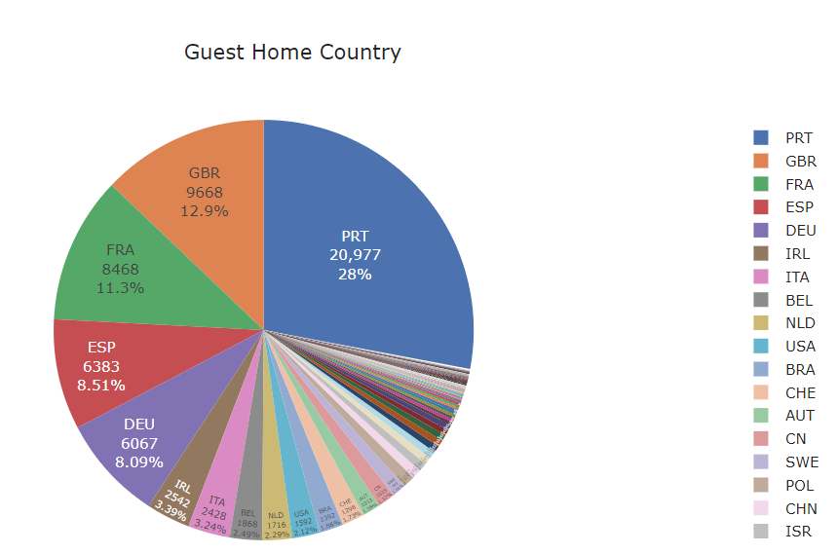
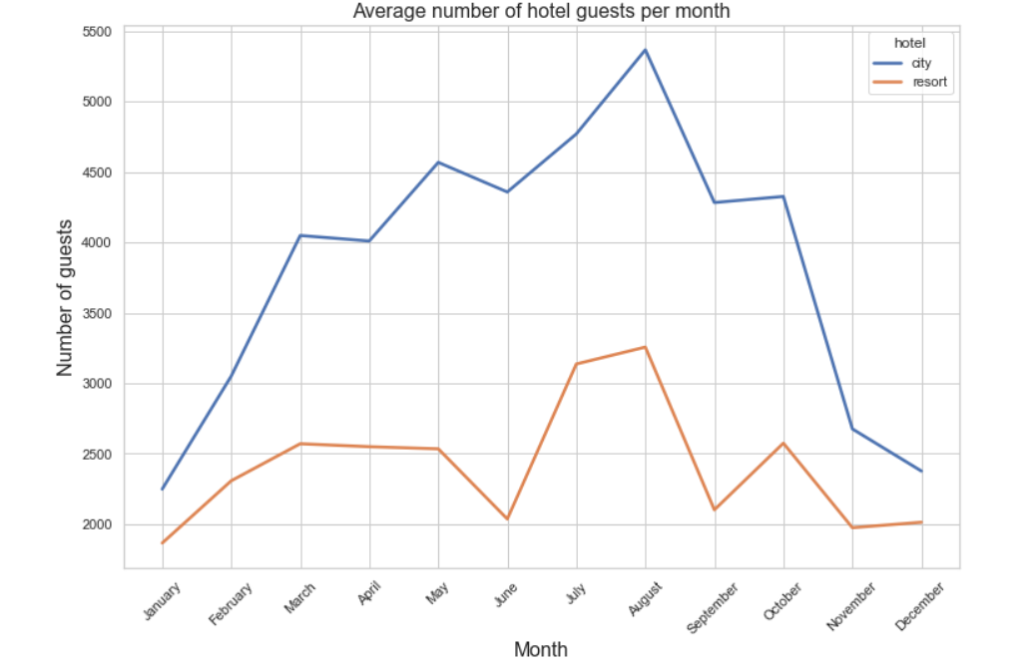
Project analysis slide 2
Explorative Data Analysis
~50% booking is done from PRT(Portugal),GBR(Great Britain) and FRA(France)
During the spring and autumn season there are more guest. Looking into the city category there is a dip from May to June and which is somehow correlated with the resort category. There is a sharp dip from August to September and rise in October month

Slide 6
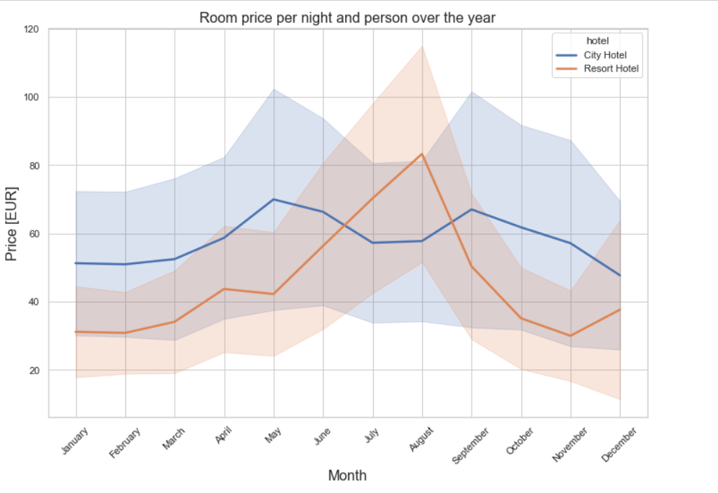
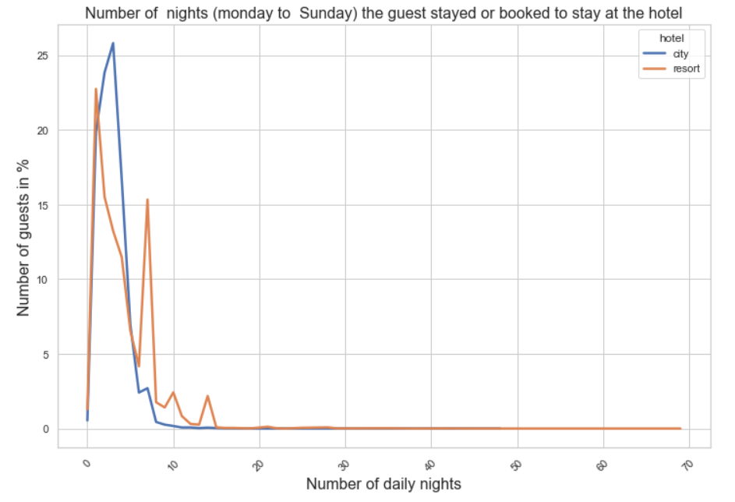
Project analysis slide 2
Explorative Data Analysis
This chart shows that the prices in the Resort hotel are much higher during the summer. The price of the city hotel varies less and is most expensive during spring and autumn
20 to 25% of the guest prefer to stay less than 6 days however a ‘V’ shape trend can be seen in the resort category where there is a trend of guest of close to 16% staying for around 7 to 8 days.

Slide 7
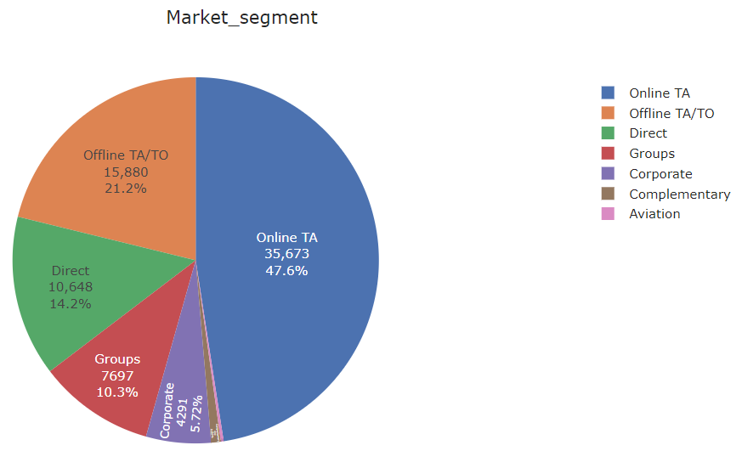
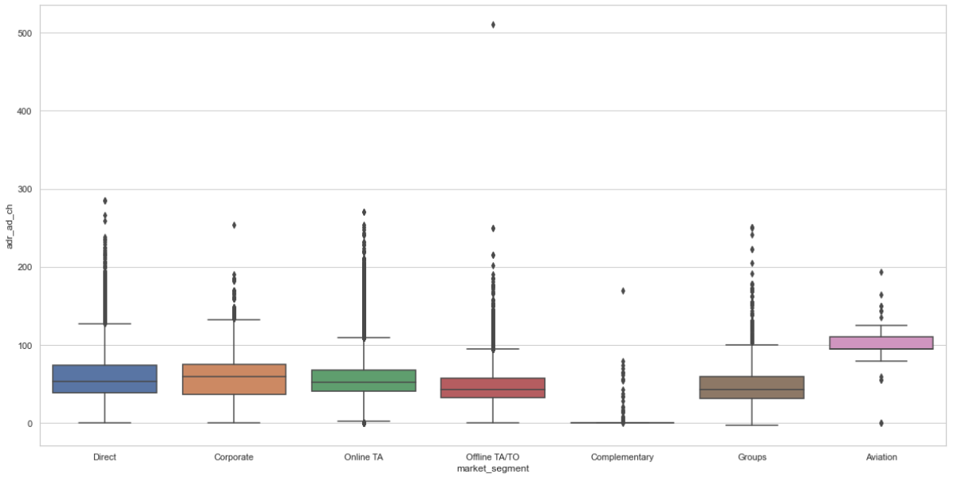
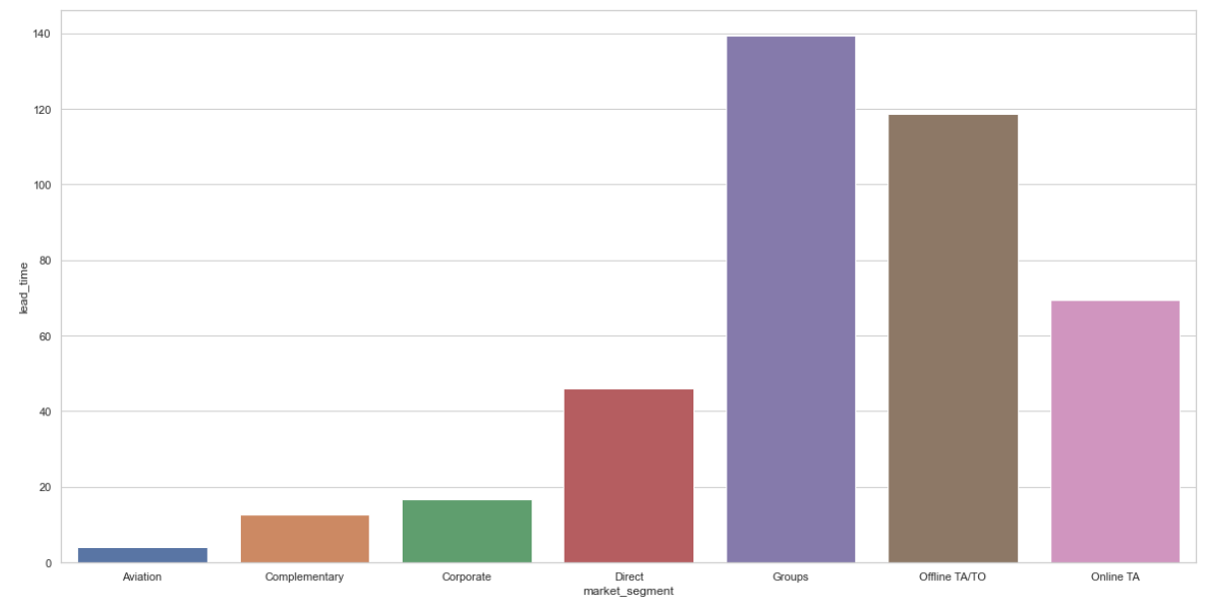
Project analysis slide 2
Explorative Data Analysis
Majority of the booking is done on online TA ~48%
Seeing at box plot distribution for the average daily rate across different market segment we can see that aviation has got the highest price
From the chart it can be assumed that due to the short lead time in aviation, the price is comparatively high for Aviation

Slide 8
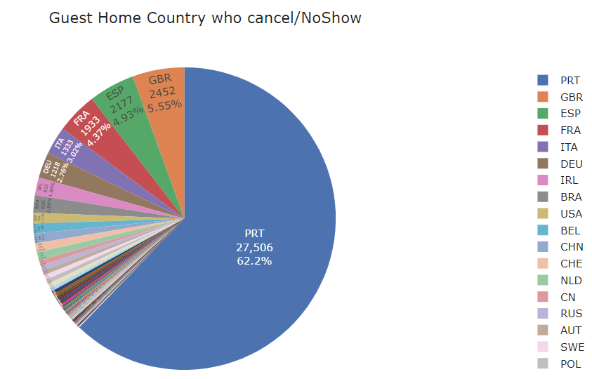
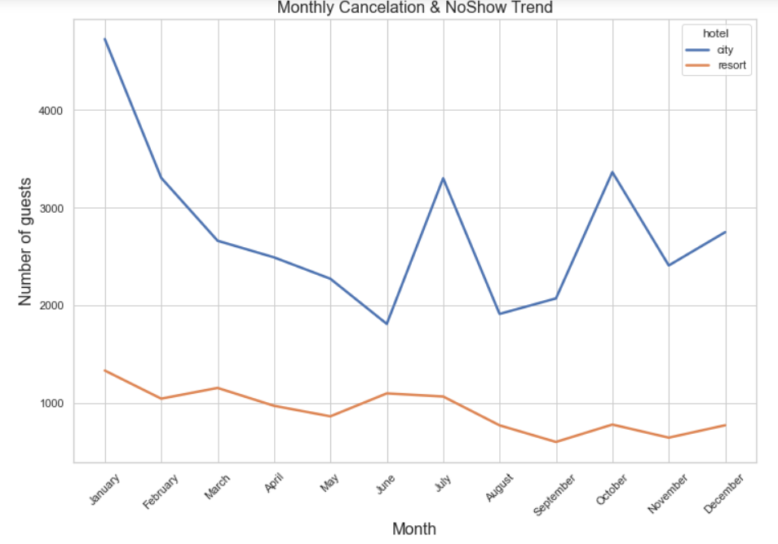
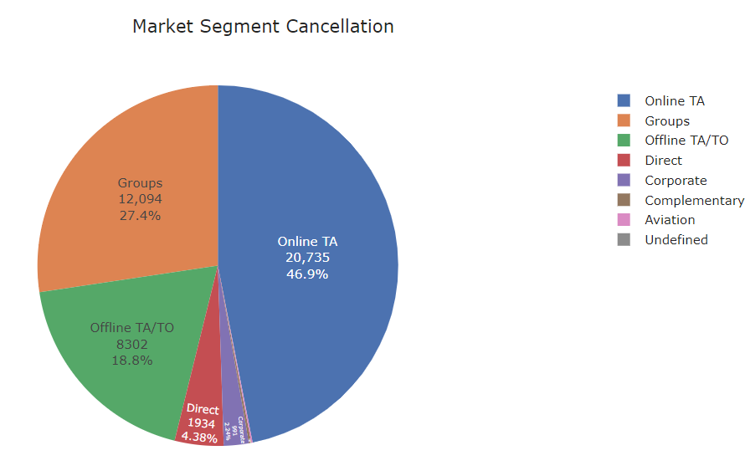
Project analysis slide 2
Explorative Data Analysis
Majority of the Cancellation happens from Portugal(PRT) ~ 63% though when compared with the actual booking it stands the highest
For the City hotel the relative number of cancelations is around 40 % throughout the year. For the Resort hotel it is highest in the summer and lowest during the winter.
Online mode has the highest cancelation ~ 21%

Slide 9
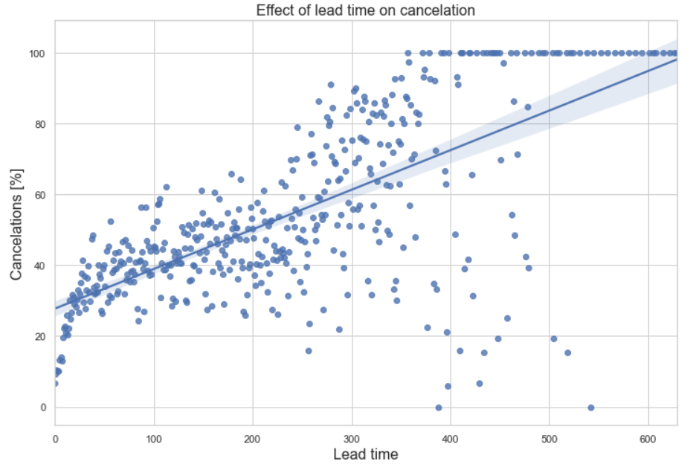
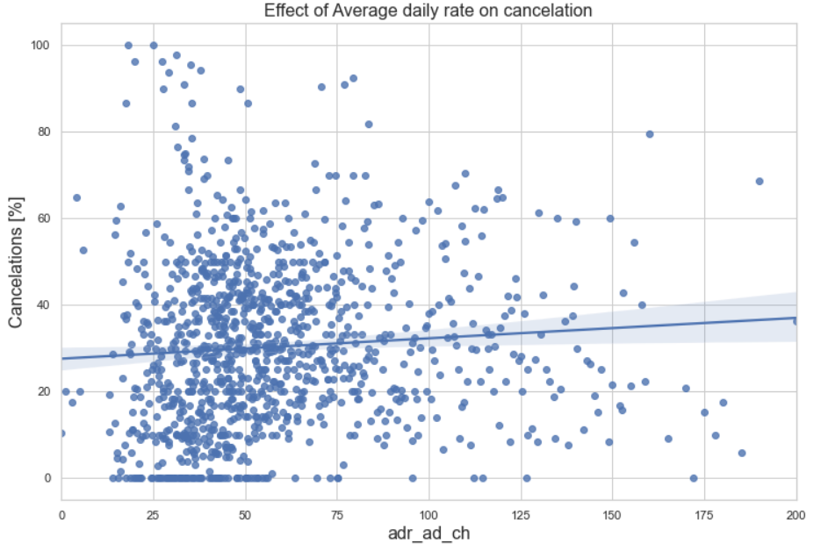
Project analysis slide 2
Explorative Data Analysis
How does Lead time impact the cancelation
Bookings made a few days before the arrival date are rarely canceled, whereas bookings made over one year in advance are canceled very often
How does Average Daily rate impact the cancelation
Though there are cancelation happening at higher average price, however it is not imperative to give a judgment basis on the price only as there are more clustered distribution in the lesser price range

Slide 10
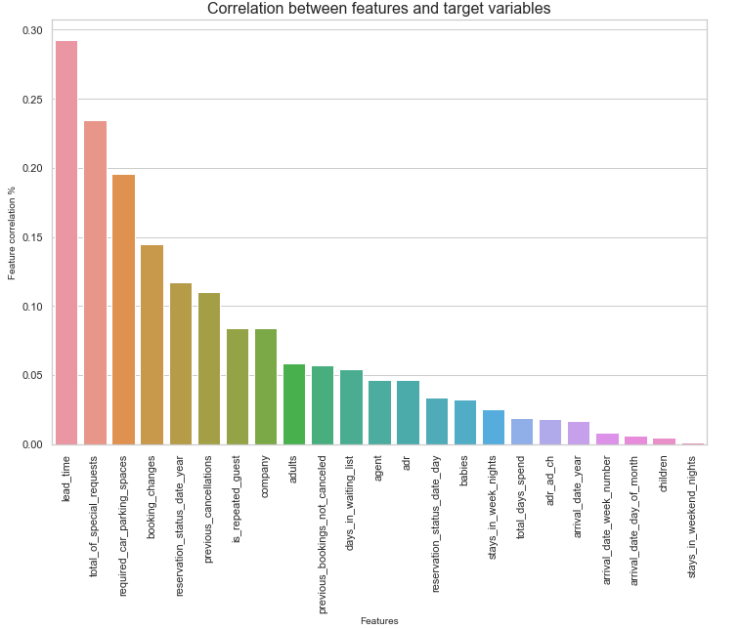
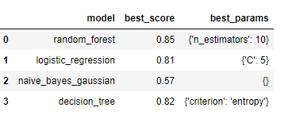
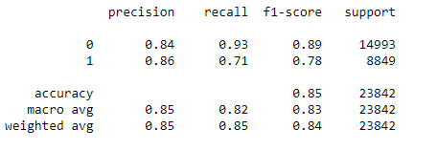
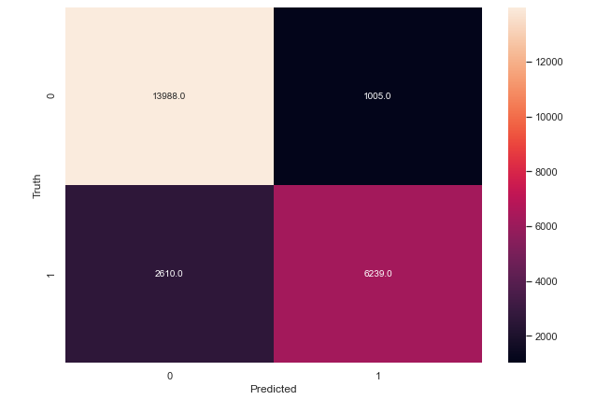
Project analysis slide 2
Model Building
Correlation between features and target variable
Lead_time, total_of_special_requests, required_car_parking_spaces, booking_changes and previous_cancellations are the 5 most important numerical features which can drive the predictive model & categorical features are transformed to one hot encoder
Grid Search Method-For best model identification
Random forest, Logistic regression and Decision tree are the best model
Classification Report-Random forest Classifier
Confusion Matrix

Slide 11
Project analysis slide 8
Model Summary
Optimizing the Lead time is very important to enhance the business. By providing value added services and providing discounts during peak season can reduce the lead time.
Random Forest Classier & Decision Tree came out to be the best model to predict the cancelation. Both the model stands at 85% and 82% accuracy.F1-score for the model for the classification is at 89% and 79% showing that misclassification error is reduced
Segmenting the historical customer basis on the booking, cancelation and no-show behavior, can help to create a recommendation engine for the segments and KYC
lead_time, total_of_special_requests, required_car_parking_spaces, booking_changes and previous_cancellations are the 5 most important numerical features which can drive the predictve model
Analyzing the current competitive pattern of booking of other hotels is also necessary. And this pattern can also be added as one of the drivers for the predictive or forecasting model
One major additional feature which is needed in the model is the comments of the customer. Through the comments we can target the real behavior or the experience of the customer and models like NLP in machine learning can really boost for strategic decision making (Sentimal analysis)
OPPORTUNITY

Slide 12
Thank You

